Slide 1

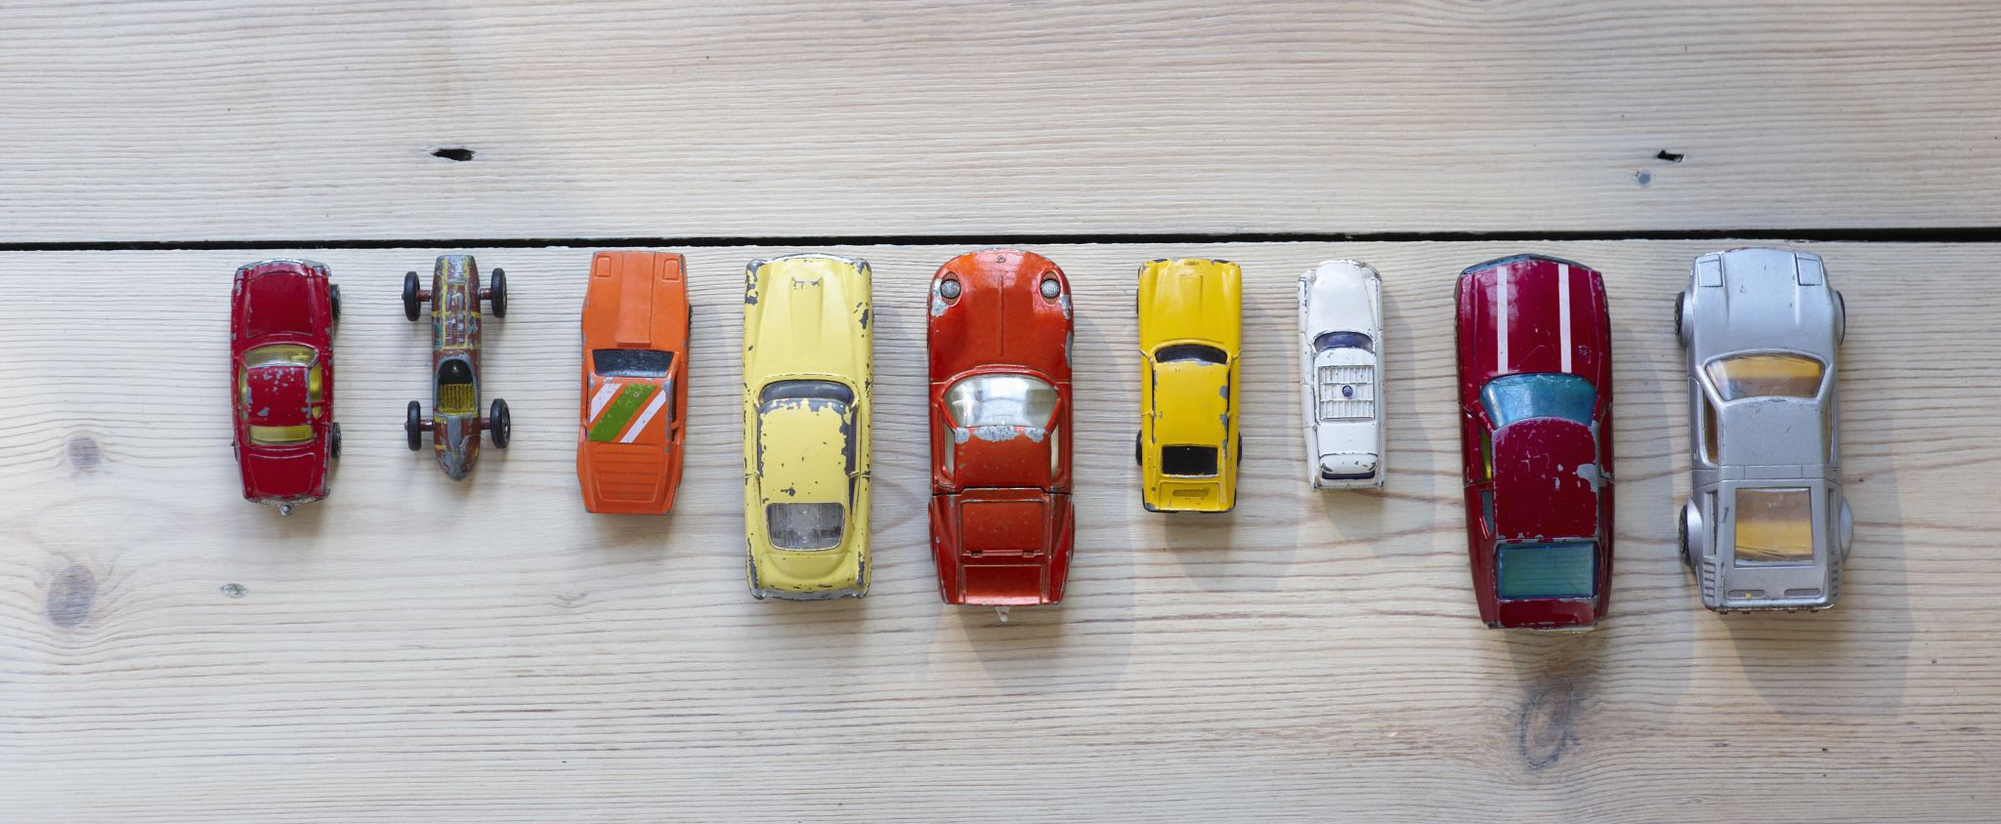




CO₂ Emissions and Fuel Consumption of Different Car Models
Zaid Al-Jawadi

Slide 2
A non-technical overview of the subject area and the problem statement/opportunity identified
Investigate CO₂ emissions across different car brands and models
Identify the relationship between different car features and fuel consumption and carbon emissions (g/km)
Assess how technology has evolved from 1995 to 2023 regarding fuel efficiency
Predict CO₂ emissions and fuel consumption based on car features

Slide 3
An overview of proposed vision for tackling the problem using Data Science
Data collection
Data preprocessing/cleaning
Exploratory data analysis (EDA)
Feature engineering
Model selection, training, and validation
Emissions forecasting

Slide 4
An estimate of the potential impact of such a solution
Showcase the differences in carbon emissions and fuel consumption between different car makes, models, and other features
Show how fuel efficiency (in terms of CO₂ emissions) has changed over time
Predicting fuel consumption and CO₂ emissions based on car features and driving conditions/patterns

Slide 5
An introduction to the dataset, including data quality concerns and findings from preliminary EDA
Data was obtained from Government of Canada (Natural Resources Canada)
Data quality: Most columns are clean with no missing values or duplicates
Two metrics, CO₂ RATING and SMOG RATING, started being tracked in 2016 and 2017, respectively
If possible, values for previous years could be deduced; otherwise, the columns will be removed

Slide 6
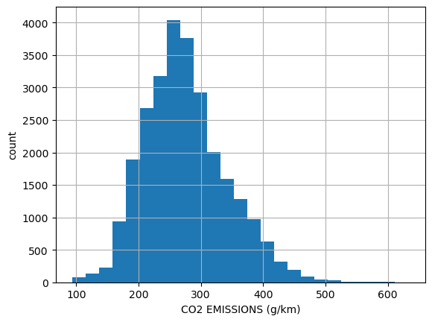
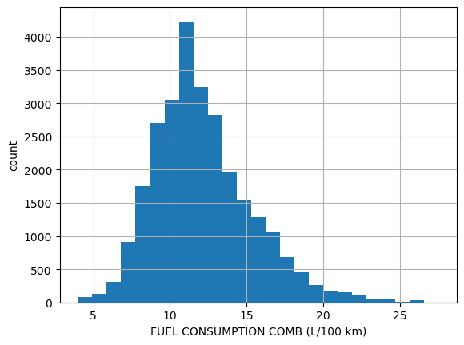
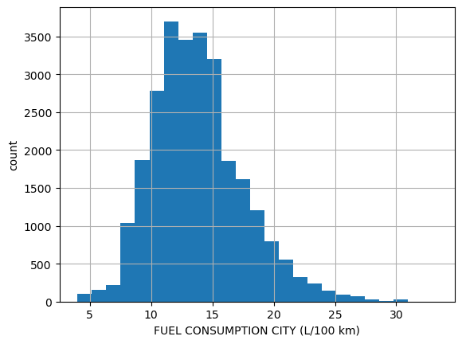
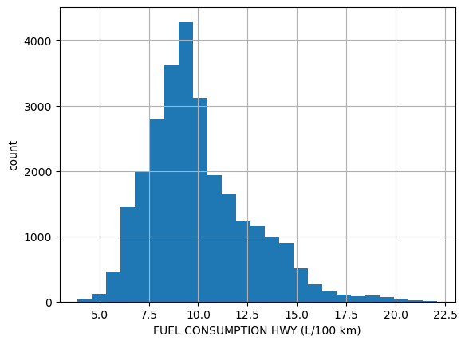
Preliminary EDA of Target Variables
Near symmetric – a slight right skew could be seen
Similar trend between CO₂ emissions and fuel consumption
Correlation coefficient close to 1

Slide 7
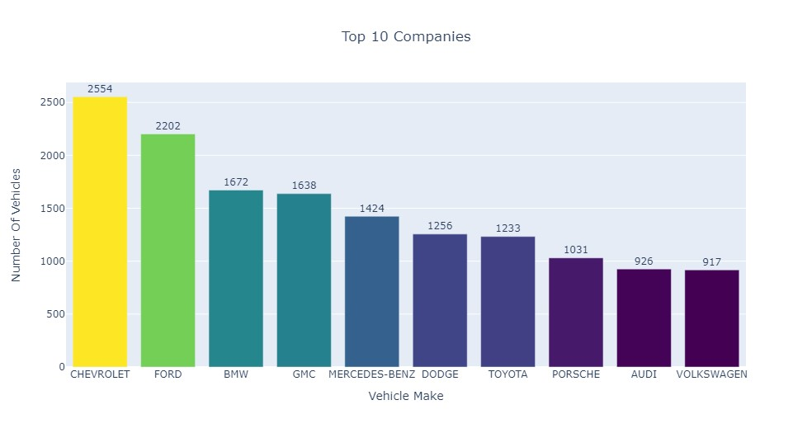
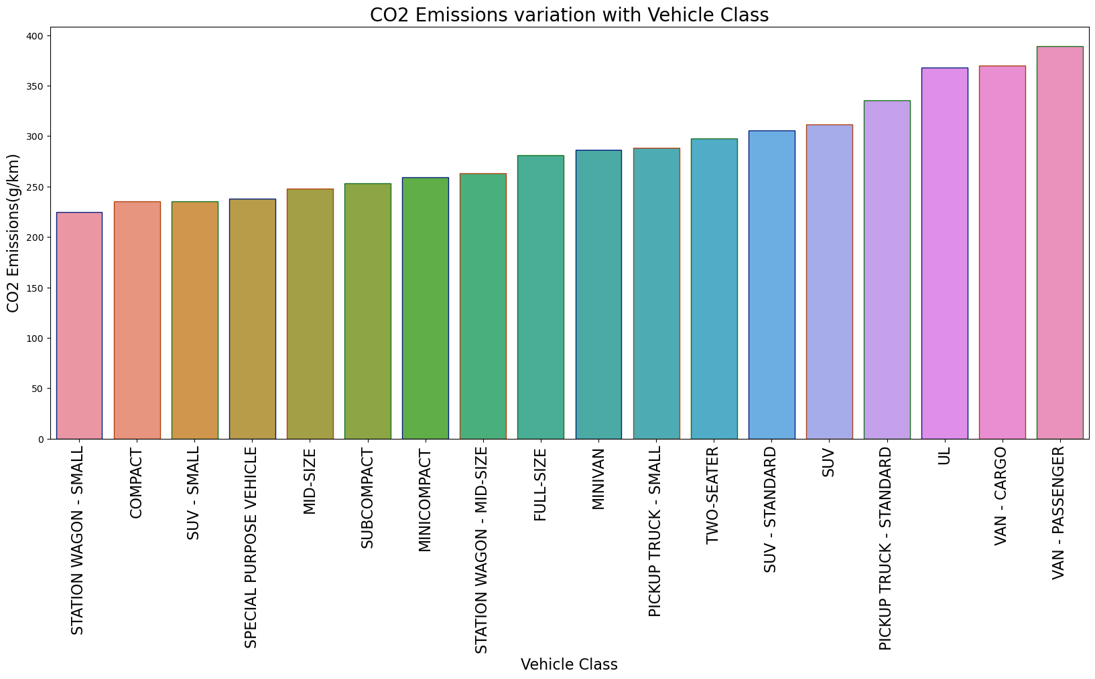
Preliminary EDA

Slide 8
Next steps in terms of data processing, feature engineering and baseline modeling
Explore relationships between different car features and CO₂ emissions
Car year and make
Vehicle class
Transmission
Engine size
Fuel type
Apply linear regression to predict CO₂ emissions and fuel consumption based on car features

Slide 9
Thank you!

